Slide 1
Project Initialization

Slide 2
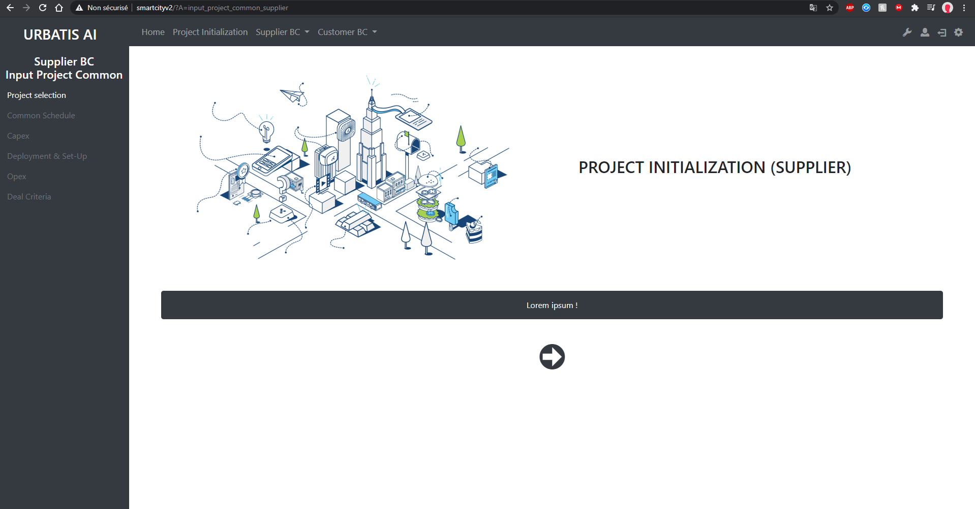
http://smartcityv2/?A=input_project_common_supplier
In this section, please select or create your project and input its main characteristics

Slide 3
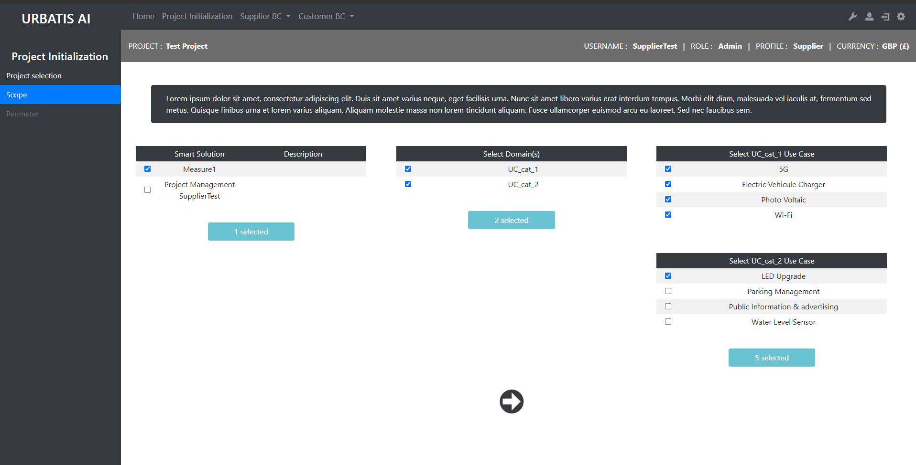
http://smartcityv2/?A=project_sdesign&A2=scope1&projID=21
In order to define the scope of the overall project, please select the relevant solution, its area(s) of application(s) and the specific Use Cases which it covers

Slide 4
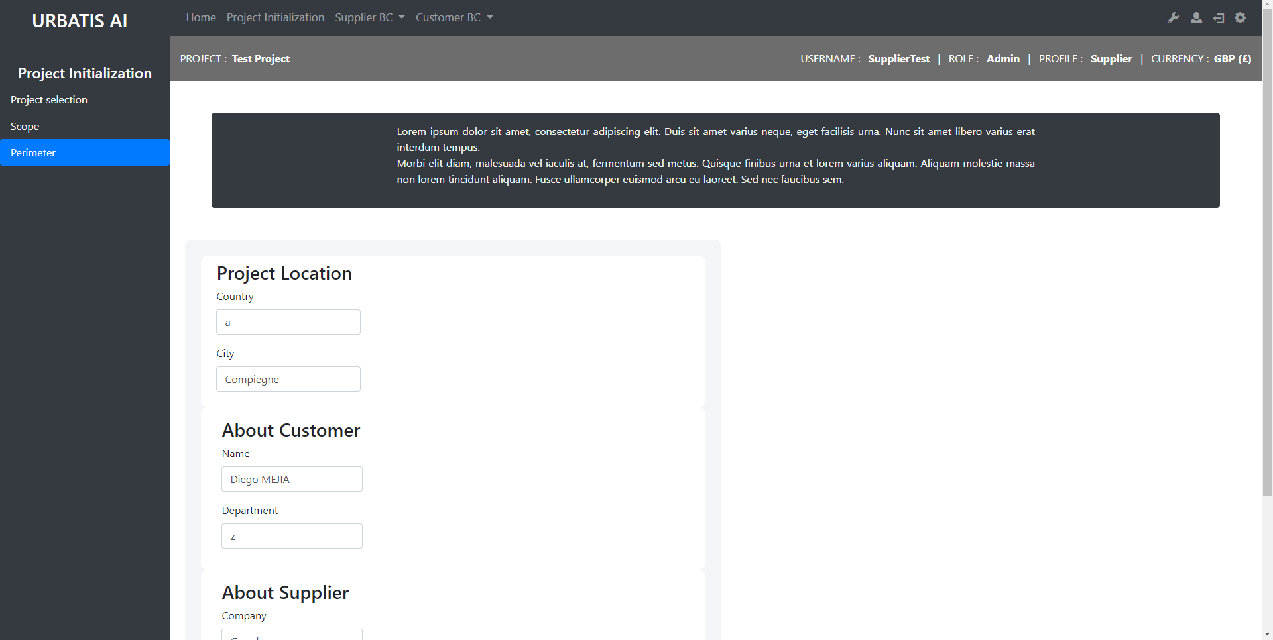
http://smartcityv2/?A=project_sdesign&A2=perimeter1&projID=21
In order to define the perimeter of the overall project, please select the project location and the relevant details
pertaining to the project promoter (client) and to the solution provider (supplier)

Slide 5
Input Project Common Supplier

Slide 6
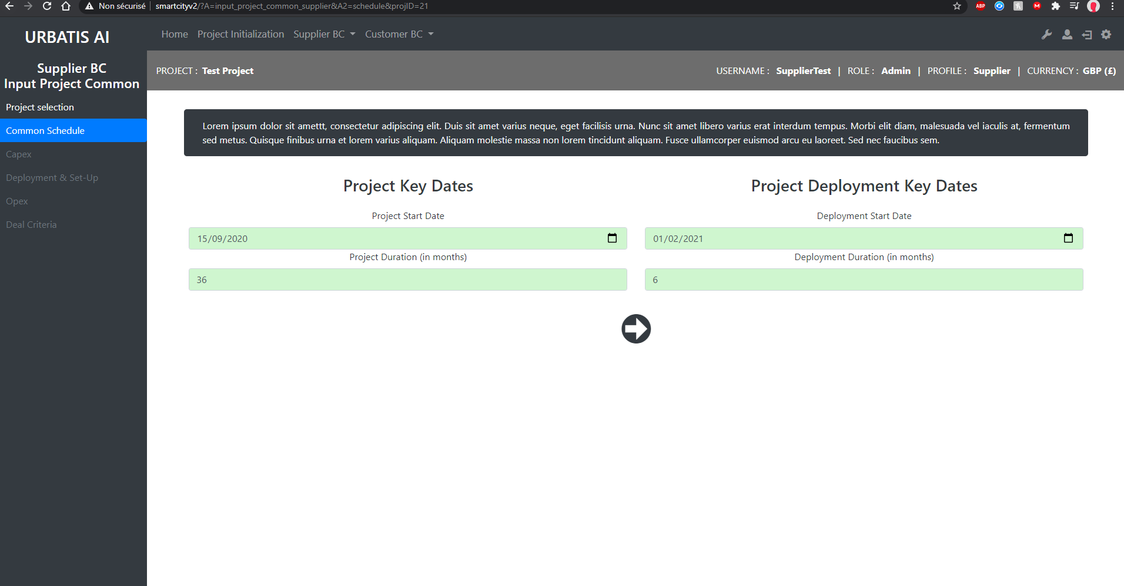
http://smartcityv2/?A=input_project_common_supplier&A2=schedule&projID=21
For the Selected Project, please input the Start and Deployment dates, as well as the respective
length of time for the project and its deployment - in number of months

Slide 7
Input Use Case Supplier

Slide 8
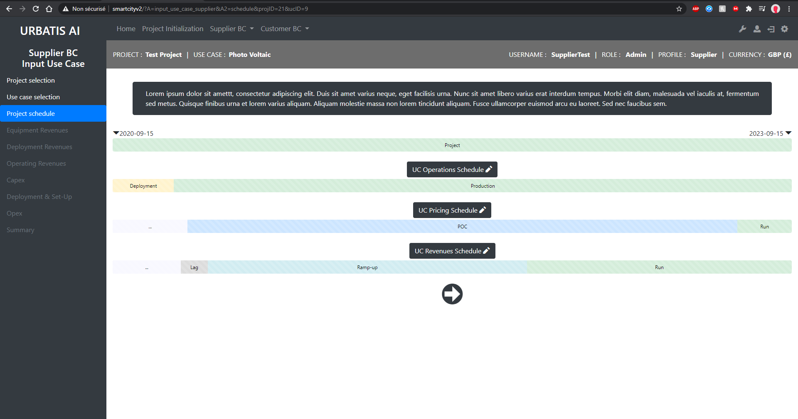
http://smartcityv2/?A=input_use_case_supplier&A2=schedule&projID=21&ucID=9
For the selected Use Case, please input the detailed Schedule, in relation to the full operational cycle beginning-to-end, in relation to the applicable pricing – during potential Proof of Concept (POC) and Full Run phases – and in relation to potential Revenues, including during potential ‘Lag’, ‘Ramp up’ and Full Run phases

Slide 9
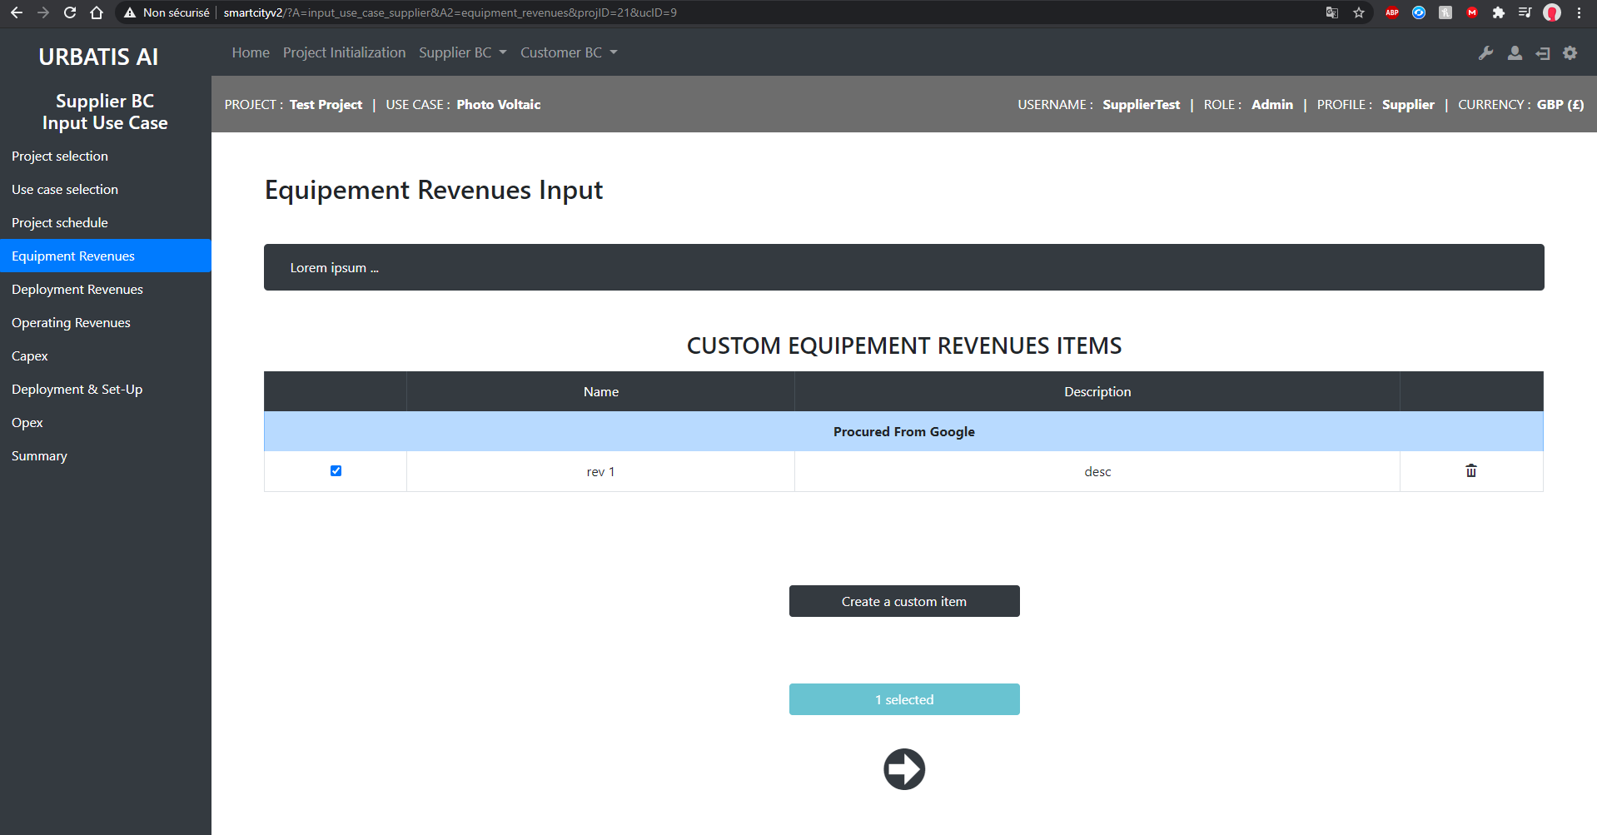
http://smartcityv2/?A=input_use_case_supplier&A2=equipment_revenues&projID=21&ucID=9
For the selected Use Case, please input and provide a short description of the relevant revenue items
for custom equipment provided in connection with the supplied solution

Slide 10
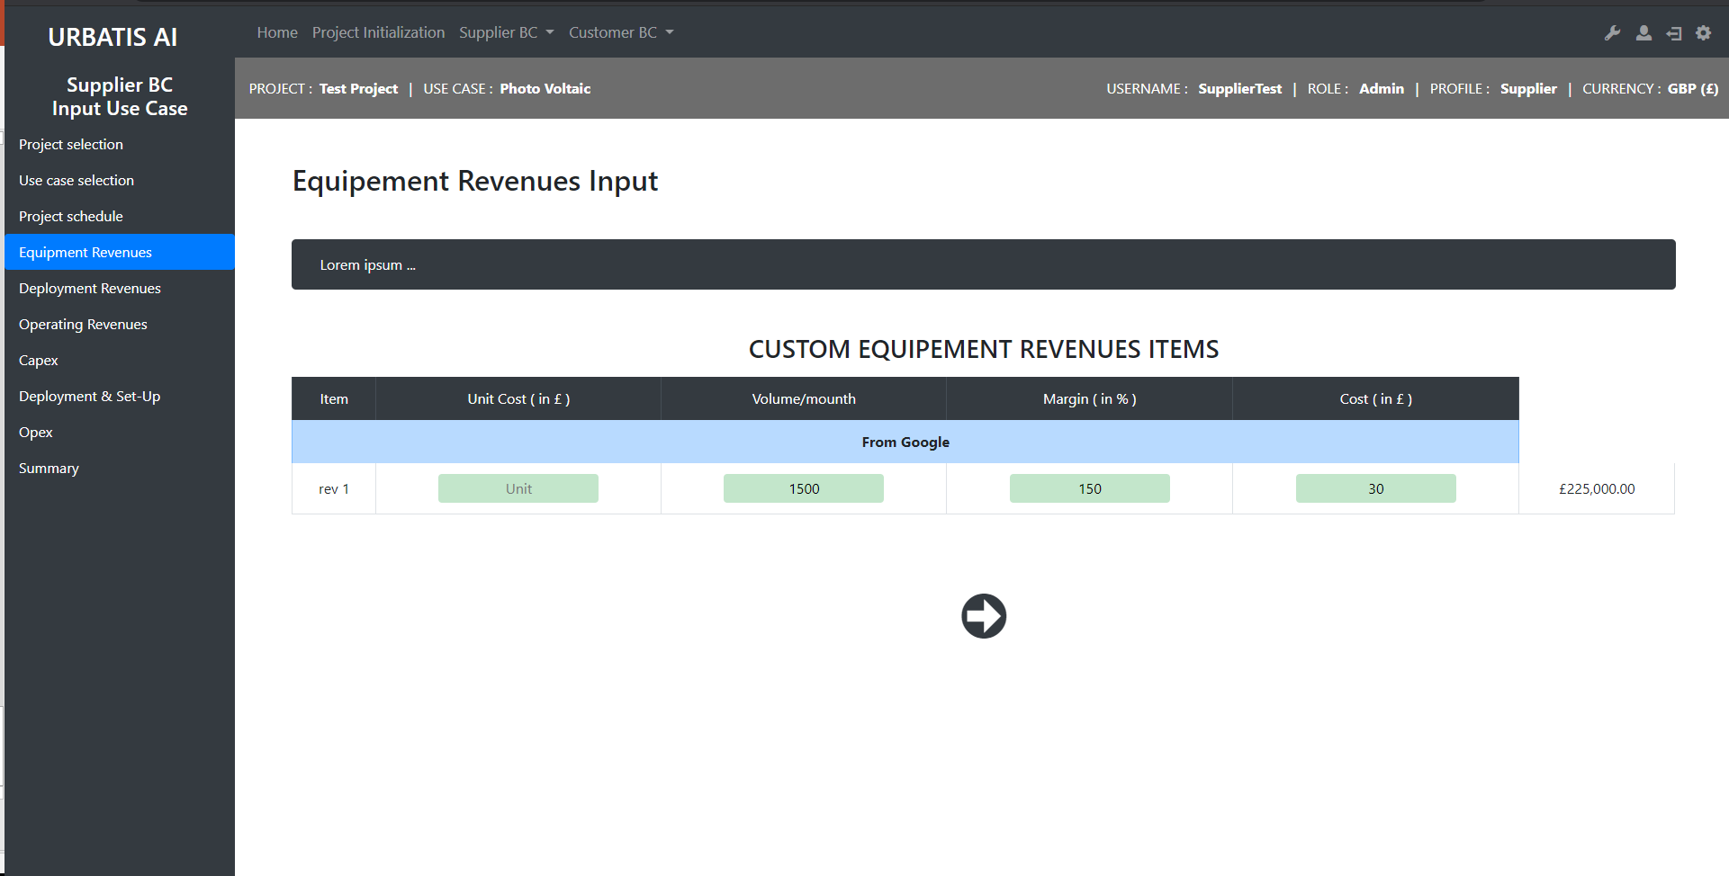
http://smartcityv2/?A=input_use_case_supplier&A2=equipment_revenues&A3=selected&projID=21&ucID=9
For each Equipment Revenue item, please input Unit Costs and Volumes (per month) to be generated from the sale of such equipment item(s)

Slide 11
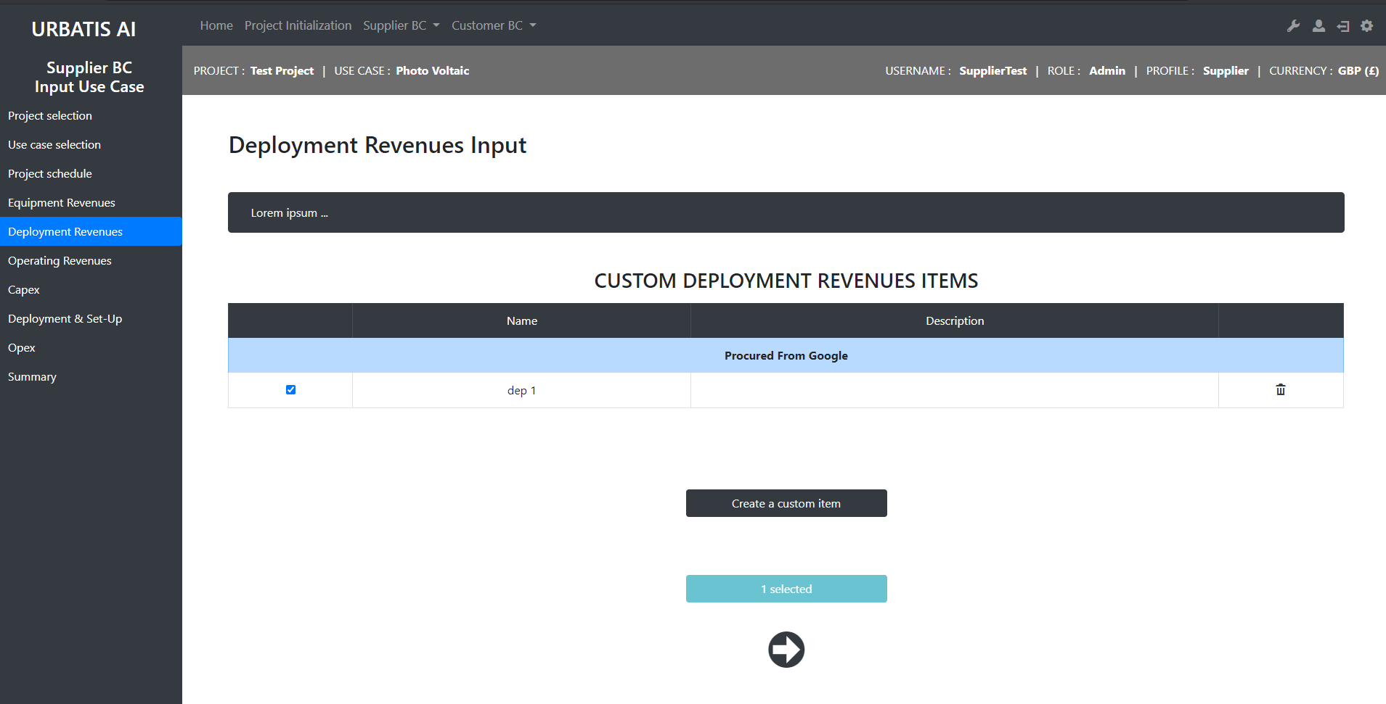
http://smartcityv2/?A=input_use_case_supplier&A2=deployment_revenues&projID=21&ucID=9
For the selected Use Case, please input and provide a short description of the relevant deployment
revenue items in connection with the supplied solution

Slide 12
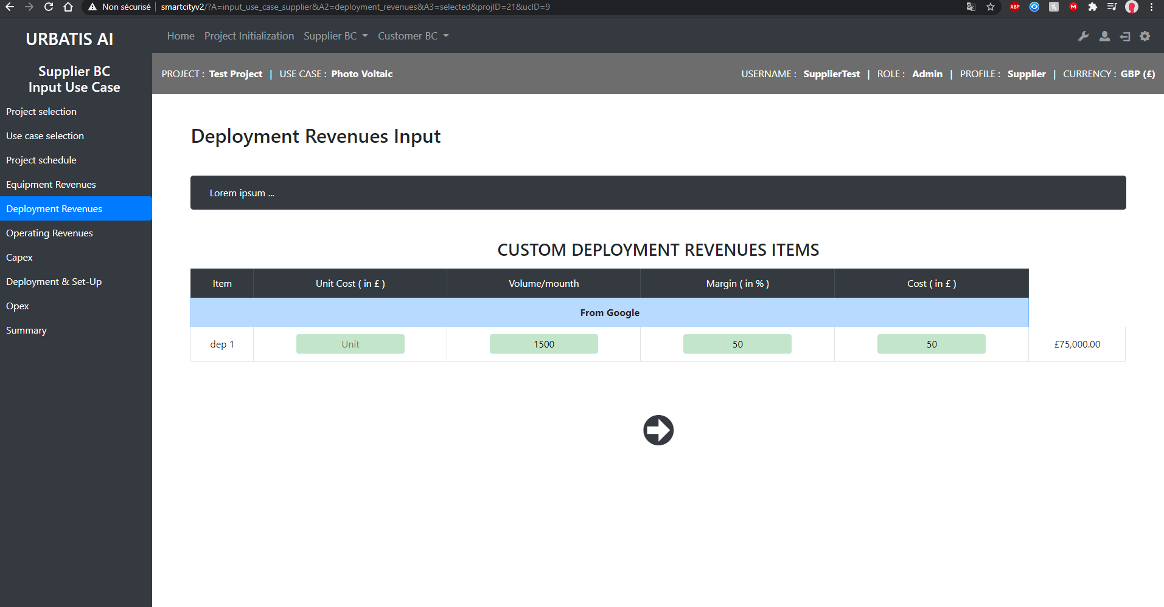
http://smartcityv2/?A=input_use_case_supplier&A2=deployment_revenues&A3=selected&projID=21&ucID=9
For each Deployment Revenue item, please input Unit Costs and Volumes (per month) to be generated from such deployment item(s)

Slide 13
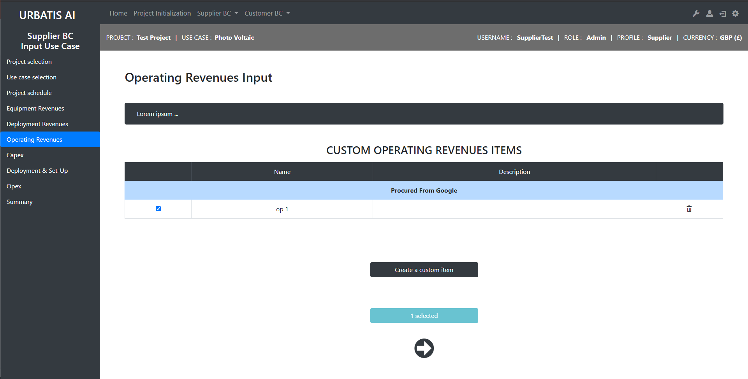
http://smartcityv2/?A=input_use_case_supplier&A2=operating_revenues&projID=21&ucID=9
For the selected Use Case, please input and provide a short description of the relevant Revenue items from Operations in connection with the supplied solution

Slide 14
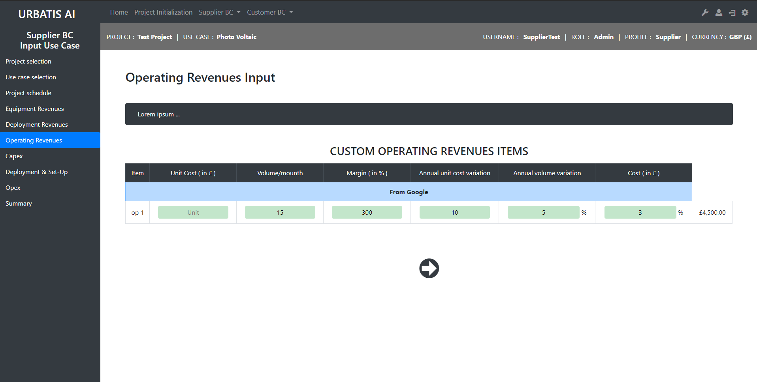
http://smartcityv2/?A=input_use_case_supplier&A2=operating_revenues&A3=selected&projID=21&ucID=9
For each Operating Revenue item, please input Unit Costs, Volumes (per month) and annual variations impacting such revenue item(s).

Slide 15
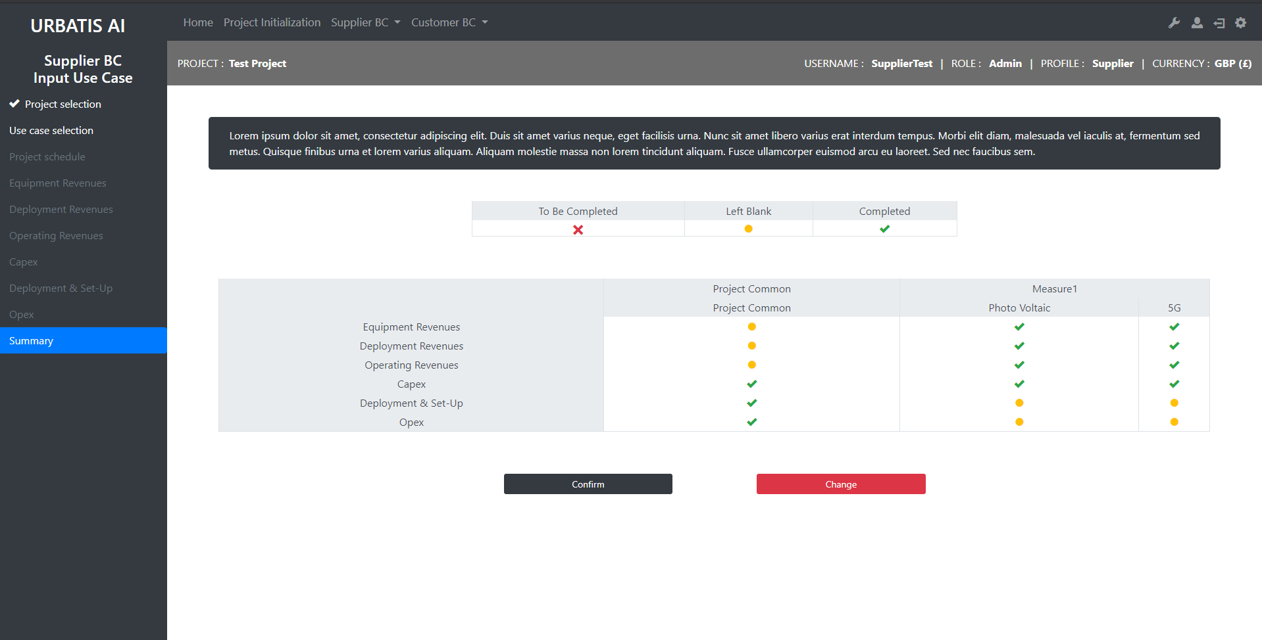
http://smartcityv2/?A=input_use_case_supplier&A2=summary&projID=21
Summary Dashboard showing the completion of the Selected Use Cases’ key Revenue / Cost items

Slide 16
Dashboard Supplier

Slide 17
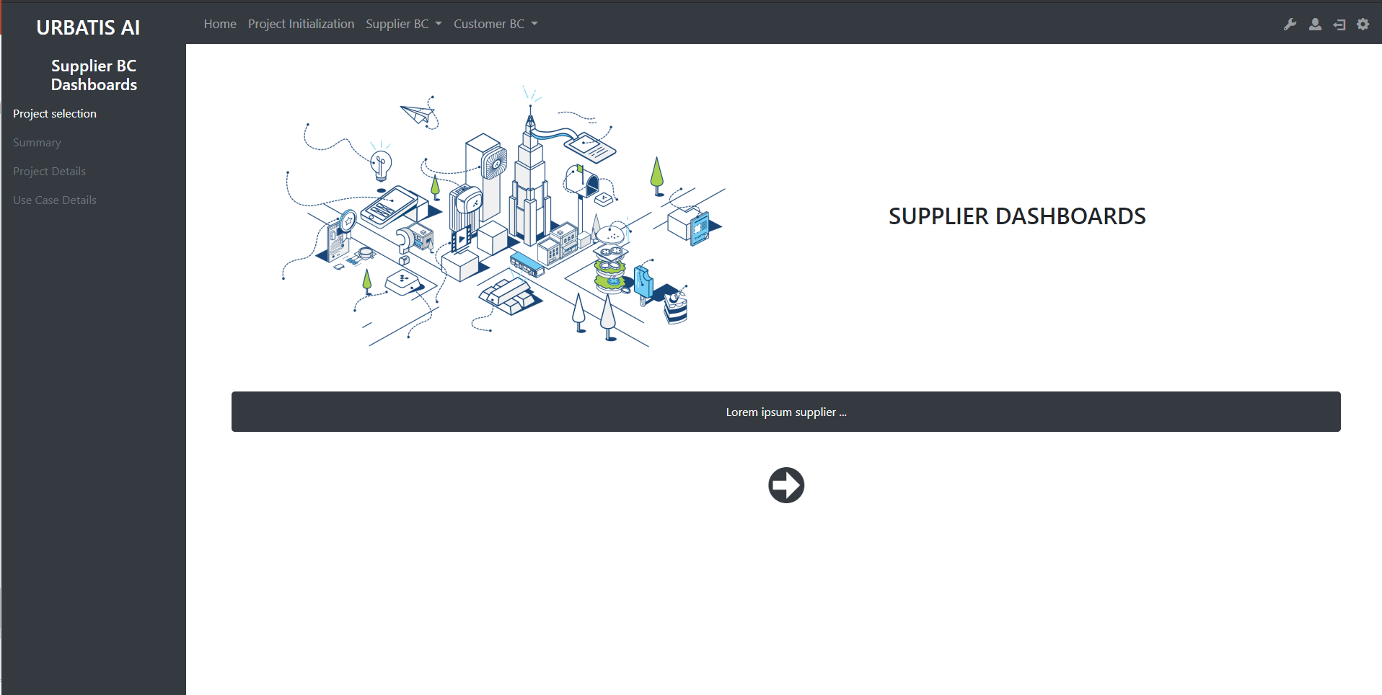
http://smartcityv2/?A=supplier_dashboards
In this section, you will find Summary dashboards of the key project metrics across the project life cycle

Slide 18
Input Project Common Customer

Slide 19
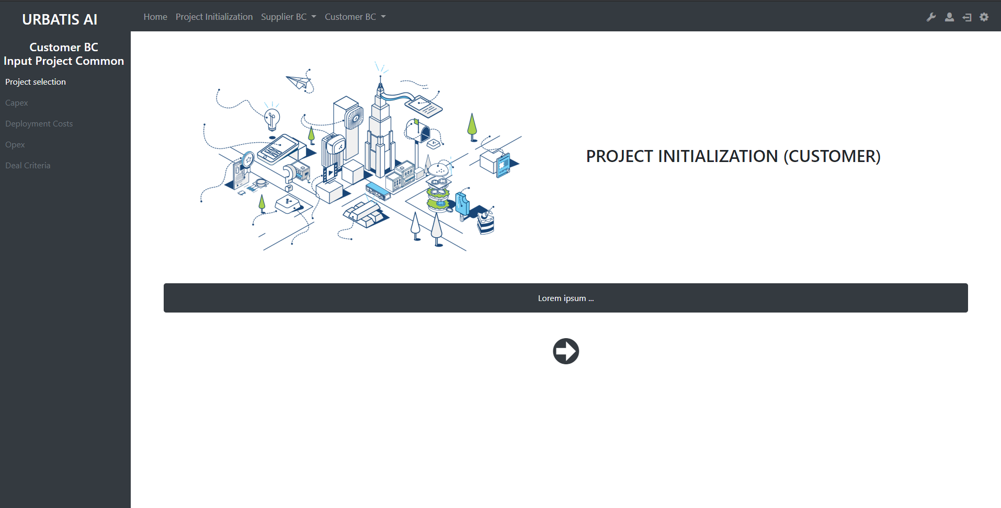
http://smartcityv2/?A=input_project_common
In this section, please input the relevant Cost Items for the selected Project and relevant Use Cases

Slide 20
Input Use Case Customer

Slide 21
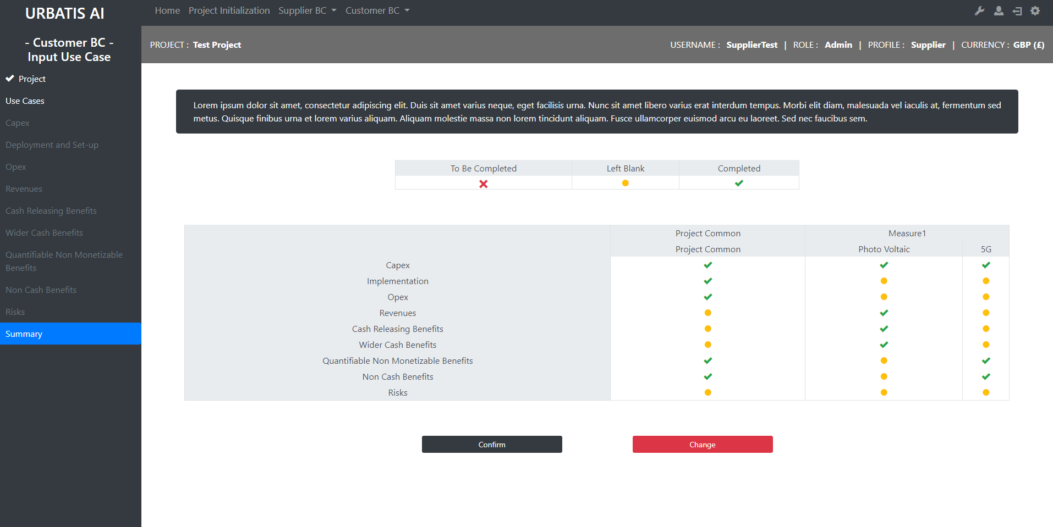
http://smartcityv2/?A=cost_benefits&A2=summary&projID=21
Summary Dashboard showing the completion of the Selected Use Cases’ key Revenue / Cost items

Slide 22
Dashboard Costumer

Slide 23
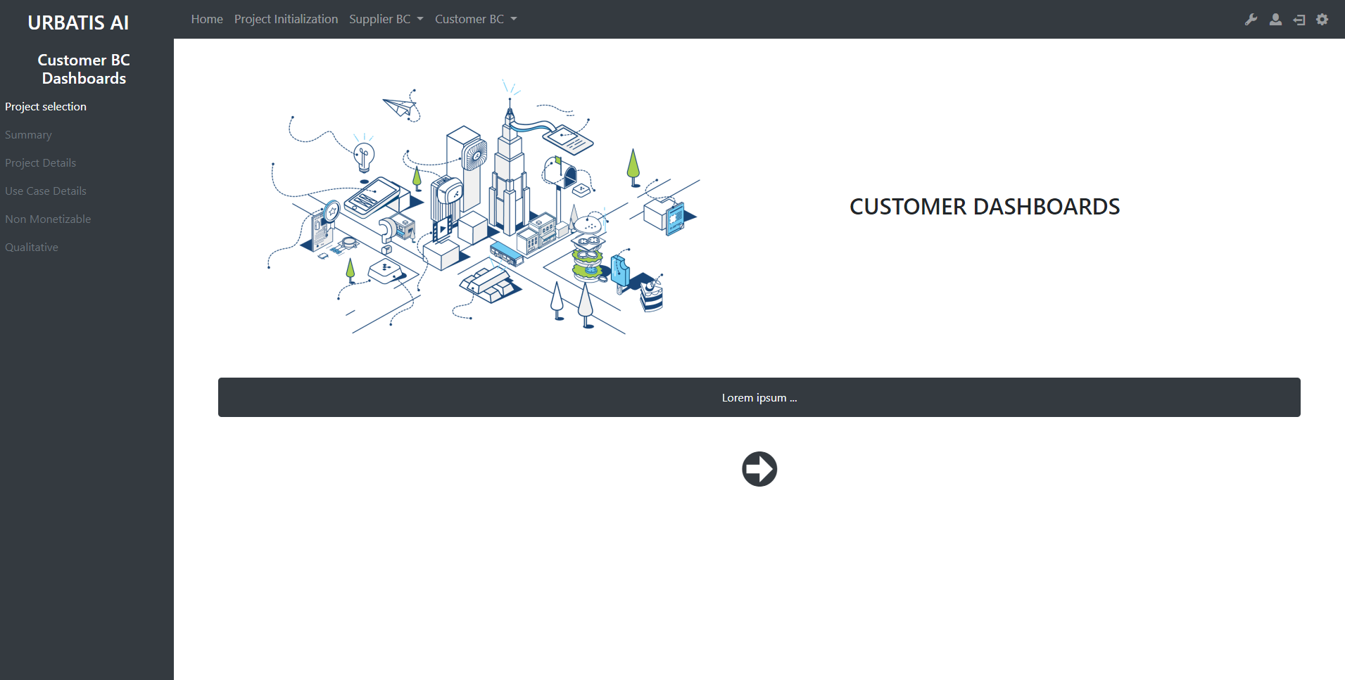
http://smartcityv2/?A=customer_dashboards
In this section, you will find Summary dashboards of the key project metrics across the project life cycle

